Slide 1
Basic I/O Interfacing 8255 or 82C55
‹#›

Slide 2
The programmable peripheral Interface
The 82C55 programmable peripheral interface (PPI) is a very popular low-cost interfacing component that is used found in many applications.
Applications range from 7-segment display, stepper motor connection, counters to key pad management.
This device is still in use today and is used to interface and detect key presses on modern keyboards, parallel printers and other interfacing chipsets.
For those of you who are doing computer interfacing course you will be extensively using this device to interface various devices with the PC.
‹#›

Slide 3
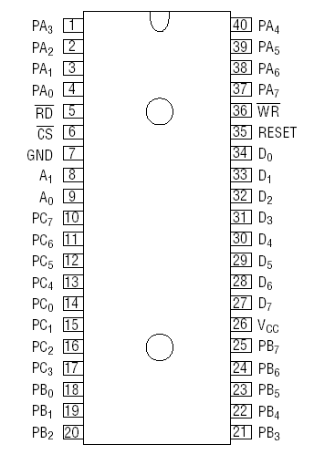
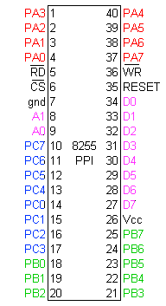
Pin Diagram 8255
‹#›

Slide 4
Connection Diagram
8 bit
Date and Address Bus
MPU
8255
Port A (8 bit)
Port C_{Upper} (4 bit)
Group A
Read (Active low)
Write (Active low)
A0
Port B (8 bit)
A1
Reset (Active high)
Port C_{Lower} (4 bit)
Group B
Chip Select (Active low)
‹#›

Slide 5
82C55
This devices has 24 pins for I/O.
The I/O pins can be programmed in groups of 12 pins.
There are three distinct modes of operation Mode 0, Mode 1 and Mode 2.
Group A connections consists of Port A(PA0-PA7) and the upper half of port C (PC4-PC7)
Group B connections consists of Port B (PB0-PB7) and the lower half of port C (PC0-PC3)
‹#›

Slide 6
Function of pins:
Data bus(D₀-D₇):These are 8-bit bi-directional buses, connected to 8085 data bus for transferring data.
CS: This is Active Low signal. When it is low, then data is transfer from 8085.
Read: This is Active Low signal, when it is Low read operation will start.
Write: This is Active Low signal, when it is Low Write operation will start.

Slide 7
82C55
CS pin is used to select the device for reading or writing.
Control lines A0 and A1 are used to select the Port that requires interaction.
A1 | A0 | Function
0 | 0 | Port A
0 | 1 | Port B
1 | 0 | Port C
1 | 1 | Command Registers
‹#›

Slide 8
RESET: This is used to reset the device. That means clear control registers.
PA₀-PA₇:It is the 8-bit bi-directional I/O pins used to send the data to peripheral or to receive the data from peripheral.
PB₀-PB₇:Similar to PA
PC₀-PC₇:This is also 8-bit bidirectional I/O pins. These lines are divided into two groups.
PC₀ to PC₃(Lower Groups)
PC₄ to PC₇ (Higher groups)
These two groups working in separately using 4 data’s.

Slide 9
Connection Diagram
8 bit
Date and Address Bus
MPU
8255
Port A (8 bit)
I/O devices
Read (Active low)
Port B (8 bit)
Write (Active low)
A0
A1
Port C_{Upper} (4 bit)
Reset (Active high)
Port C_{Lower} (4 bit)
Chip Select (Active low)
A1 | A0 | Function
0 | 0 | Port A
0 | 1 | Port B
1 | 0 | Port C
1 | 1 | Command Registers
‹#›

Slide 10
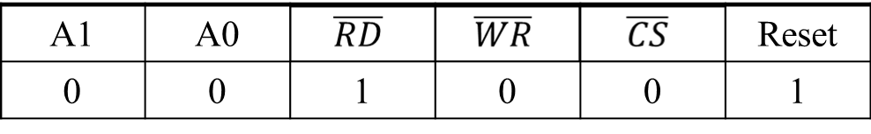
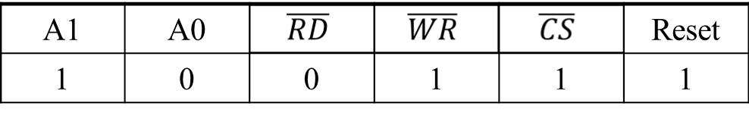
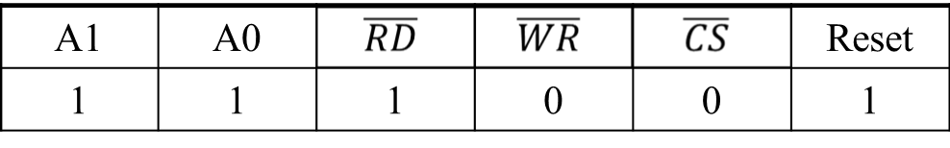
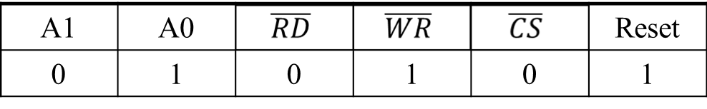
Click on Correct Answer
Data Bus → Port A
Data Bus → Port C
Data Bus → Control
Data Bus → Port C
Data Bus ← Port C
Nothing Happen
Data Bus ← Port A
Data Bus → Port C
Data Bus → Control
Date Bus ← Port B
Date Bus → Port B
Date Bus → Control
‹#›

Slide 11
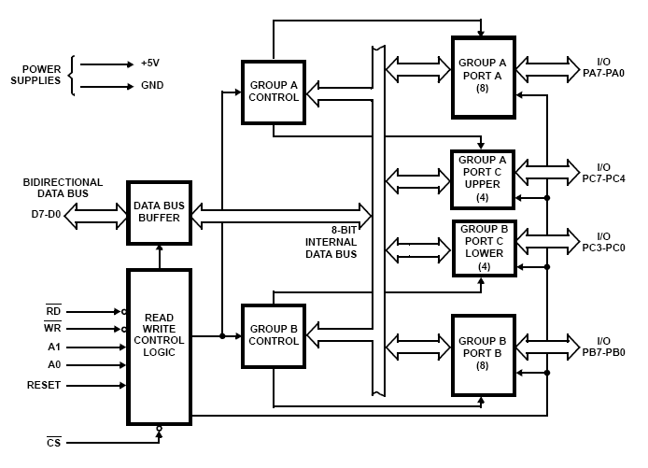
Block Diagram

Slide 12
Data Bus buffer:
It is a 8-bit bidirectional Data bus.
Used to interface between 8255 data bus with system bus.
The internal data bus and Outer pins D₀-D₇ pins are connected in internally.
The direction of data buffer is decided by Read/Control Logic.

Slide 13
Group A and Group B control:
Group A and B get the Control
Signal from CPU and send the command to the individual control blocks.
Group A send the control signal to port A and Port C (Upper) PC7-PC4.
Group B send the control signal to port B and Port C (Lower) PC3-PC0.
PORT A:
This is a 8-bit buffered I/O latch.
It can be programmed by mode 0 , mode 1, mode 2 .

Slide 14
PORT B:
This is a 8-bit buffer I/O latch.
It can be programmed by mode 0 and mode 1.
PORT C:
This is a 8-bit Unlatched buffer Input and an Output latch.
It is splitted into two parts.
It can be programmed by bit set/reset operation.

Slide 15
8255 or 82C55 Part-2
Dr. Md. Khalilur Rhaman
Associate Professor
CSE Department
BRAC University
‹#›

Slide 16
Operation modes:
BIT SET/RESET MODE:
The PORT C can be Set or Reset by sending OUT instruction to the CONTROL registers.
I/O MODES:
MODE 0(Simple input / Output):
In this mode , port A, port B and port C is used as individually (Simply).
Features:
Outputs are latched, Inputs are buffered not latched.
Ports do not have Handshake or interrupt capability.

Slide 17
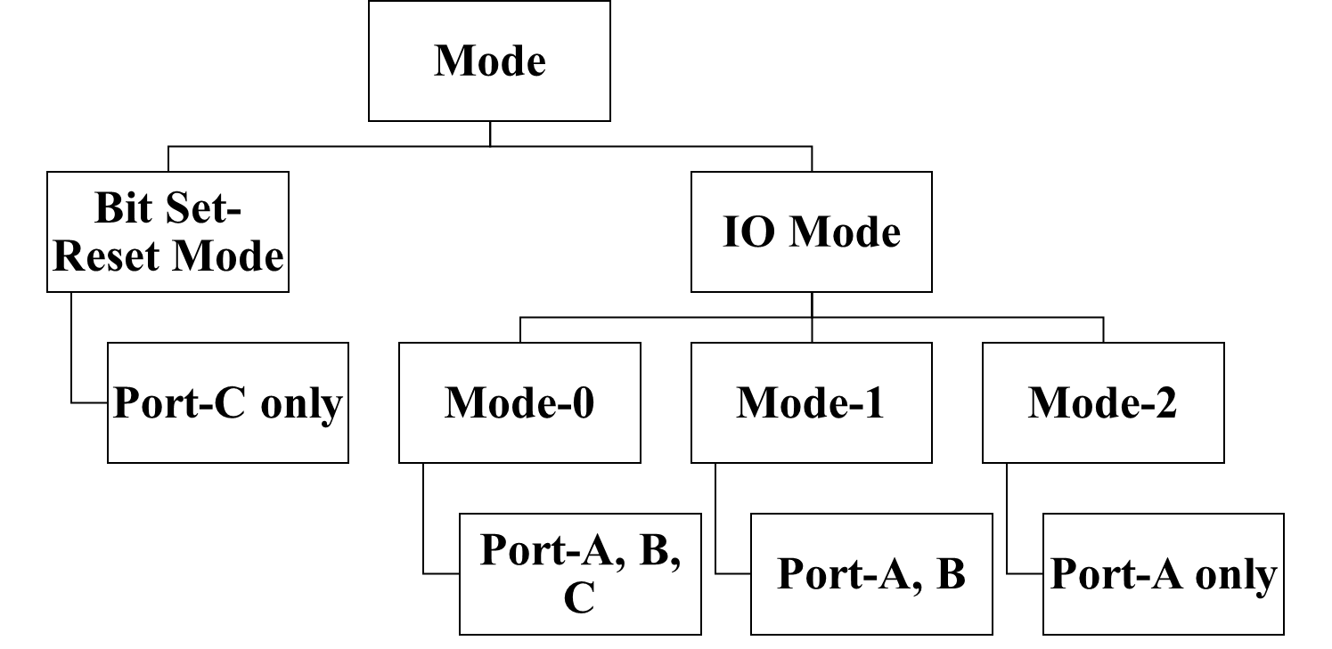
Mode
‹#›

Slide 18
Bit Set-Reset Mode
MPU
8255
Port A (8 bit)
0XXX0110
Control
Register
Read 🡪 1
Port B (8 bit)
Write 🡪 0
A0 🡪 1
PC₇
A1 🡪 1
Port C
Reset 🡪 0
1
Chip Select 🡪 0
PC₀
PC₃=011
0 | X | X | X | 0 | 1 | 1 | 1
Control Register
‹#›

Slide 19
Bit Set-Reset Mode
MPU
8255
Port A (8 bit)
0XXX0110
Control
Register
Read 🡪 1
Port B (8 bit)
Write 🡪 0
A0 🡪 1
PC₇
0
A1 🡪 1
Port C
Reset 🡪 0
Chip Select 🡪 0
PC₀
PC₇=111
0 | X | X | X | 1 | 1 | 1 | 0
Control Register
‹#›

Slide 20
MODE 1 :(Input/output with Hand shake)
In this mode, input or output is transferred by hand shaking Signals.
Handshaking signals is used to transfer data between whose data transfer is not same.
Computer
DATA BUS
STB
ACK
Busy
Printer

Slide 21
Example:
The computer send the data to the printer large speed compared to the printer.
When computer send the data according to the printer speed at the time only, printer can accept.
If printer is not ready to accept the data then after sending the data bus , computer uses another handshaking signal to tell printer that valid data is available on the data bus.
Each port uses three lines from port C as handshake signals

Slide 22

Mode-2
8255
Port A (8 bit)
Control
Register
Touch
Screen
Port C_{Upper} (Pin 3, 4, 5, 6, 7)
‹#›

Slide 23
MODE 2:bi-directional I/O data transfer:
This mode allows bidirectional data transfer over a single 8-bit data bus using handshake signals.
This feature is possible only Group A
Port A is working as 8-biy bidirectional.
PC3-PC7 is used for handshaking purpose.
The data is sent by CPU through this port , when the peripheral request it.
CONTROL WORD FORMATS:
In the INPUT mode , When RESET is High all 24 pins (3-ports) be a input mode.

Slide 24
i.e all flip flops are cleared and the interrupts are rest.
This condition is maintained even after RESET goes low.
This can be avoid by writing single control word to the control registers , when required.

Slide 25
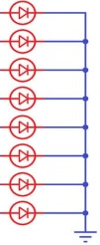
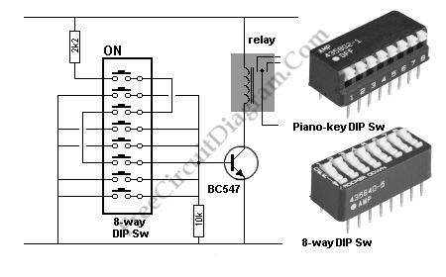
Writing to Control word for Mode-0
Port A (8 bit)
8 LED
MPU
8255
Control
Register
Read 🡪 1
Port B (8 bit)
Write 🡪 0
8 LED
A0 🡪 1
A1 🡪 1
Port C_{Upper} (4 bit)
Reset 🡪 0
Port C_{Lower} (4 bit)
Switches
Chip Select 🡪 0
Control Register
‹#›

Slide 26

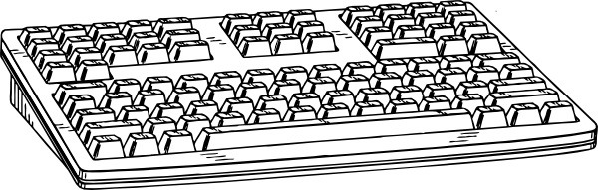
Writing to Control word for Mode-1
MPU
8255
Port A (8 bit)
Control
Register
Printer
Read 🡪 1
Write 🡪 0
Port C_{Upper} (Pin 3, 6, 7)
A0 🡪 1
Port B (8 bit)
A1 🡪 1
Reset 🡪 0
Keyboard
Chip Select 🡪 0
Port C_{Lower} (Pin 1, 2, 3)
Control Register
‹#›

Slide 27
Writing to Control word for Mode-2
MPU
8255
Port A (8 bit)
Control
Register
Touch
Screen
Read 🡪 1
Write 🡪 0
Port C_{Upper} (Pin 3, 4, 5, 6, 7)
A0 🡪 1
Port B (8 bit)
A1 🡪 1
Reset 🡪 0
Keyboard
Chip Select 🡪 0
Port C_{Lower} (Pin 1, 2, 3)
Control Register
‹#›

Slide 28
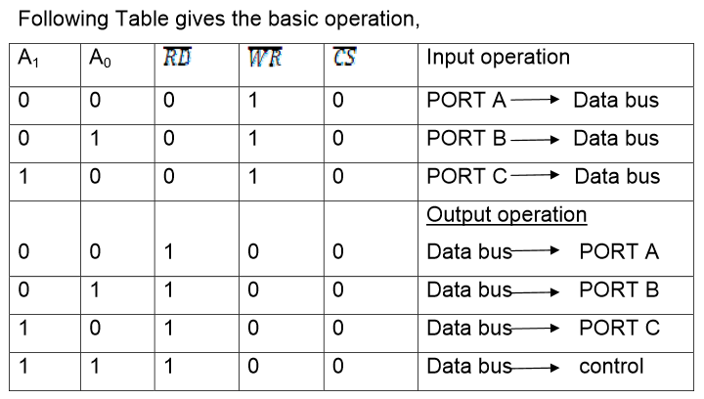

Slide 30
FOR BIT SET/RESET MODE:
This is bit set/reset control word format.
X X X
Don’t care
Bit select
B0
B1
B2
D7 | D6 | D5 | D4 | D3 | D2 | D1 | D0
BIT SET/RESET
1=SET
0=RESET
0 | 1 | 2 | 3 | 4 | 5 | 6 | 7
0 | 1 | 0 | 1 | 0 | 1 | 0 | 1
0 | 0 | 1 | 1 | 0 | 0 | 1 | 1
0 | 0 | 0 | 0 | 1 | 1 | 1 | 1
BIT SET/RESET FLAG
=0 Active

Slide 31
PC0-PC7 is set or reset as per the status of D0.
A BSR word is written for each bit
Example:
PC3 is Set then control register will be 0XXX0111.
PC4 is Reset then control register will be 0XXX1000.
X is a don’t care.

Slide 32
Click on Correct Answer
PC₇ Set
PC₂ Reset
Both are wrong answer
01111110🡪
01010XXX
0XXX1010
0XXX1011
We want to PC5 set🡪
PC₀ Set
PC₇ Reset
Both are wrong answer
00000000🡪
PC₂ Set
PC₂ Reset
In I/O Mode
01010101🡪
‹#›

Slide 33
FOR I/O MODE:
The mode format for I/O as shown in figure
D7 | D6 | D5 | D4 | D3 | D2 | D1 | D0
Group A
Port C Upper 1=Input 0=Output
Port A 1=Input 0=Output
Mode selection 00=mode 0 01=mode 1 1x=mode 2
Group B
Port C Lower 1=Input 0=Output
Port B 1=Input 0=Output
Mode selection 0=mode 0 1=mode 1
Mode set flag=1=Active

Slide 34
The control word for both mode is same.
Bit D7 is used for specifying whether word loaded in to Bit set/reset mode or Mode definition word.
D7=1=Mode definition mode.
D7=0=Bit set/Reset mode.

Slide 35
Programming 8255
Mode 0:
Ports A, B, and C can be individually programmed as input or output ports
Port C is divided into two 4-bit ports which are independent from each other
Mode 1:
Ports A and B are programmed as input or output ports
Port C is used for handshaking
PA[7:0]
PA[7:0]
PC4
STB_{A}
PC7
OBF_{A}
PC5
IBF_{A}
PC6
ACK_{A}
PC3
INTR_{A}
PC3
INTR_{A}
8255
PB[7:0]
8255
PB[7:0]
PC2
STB_{B}
PC2
OBF_{B}
PC1
IBF_{B}
PC1
ACK_{B}
PC0
INTR_{B}
PC0
INTR_{B}
PC6, 7
PC4, 5
11-‹#›

Slide 36
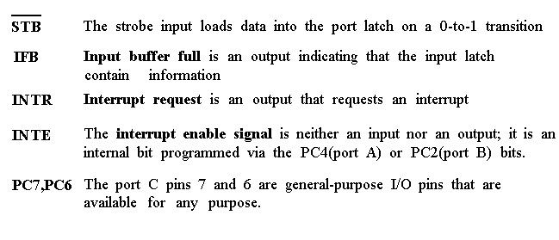
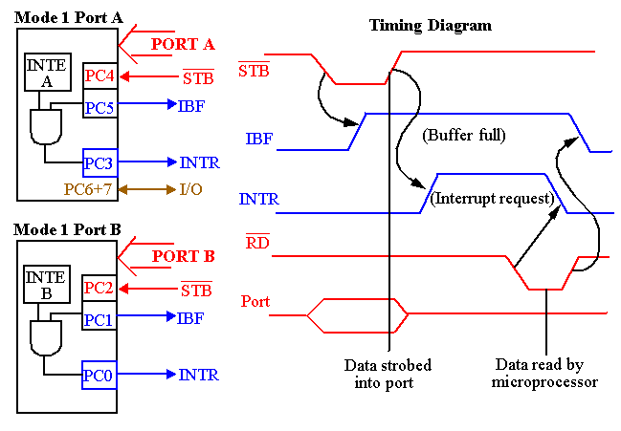

Slide 37
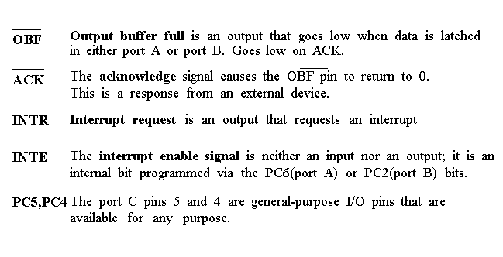
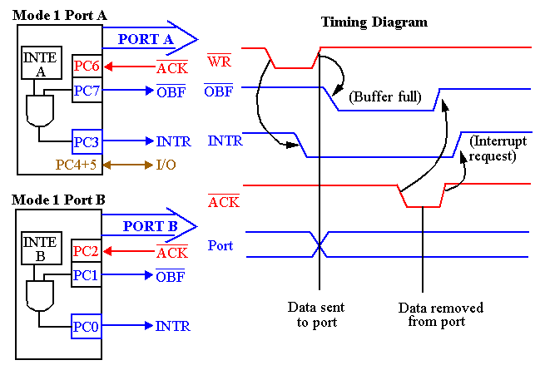

Slide 38
Programming 8255
Mode 2:
Port A is programmed to be bi-directional
Port C is for handshaking
Port B can be either input or output in mode 0 or mode 1
PA[7:0]
PC7
OBF_{A}
PC6
ACK_{A}
PC4
STB_{A}
8255
PC5
IBF_{A}
PC3
INTR_{A}
PC0
In Out
In Out
In Out
STB_{B} OBF_{B}
IBF_{B} ACK_{B}
INTR_{B} INTR_{B}
PC0
PC0
PB[7:0]
Mode 0
Mode 1
Can you design a decoder for an 8255 chip such that its base address is 40H?
Write the instructions that set 8255 into mode 0, port A as input, port B as output, PC0-PC3 as input, PC4-PC7 as output ?
11-‹#›

Slide 39
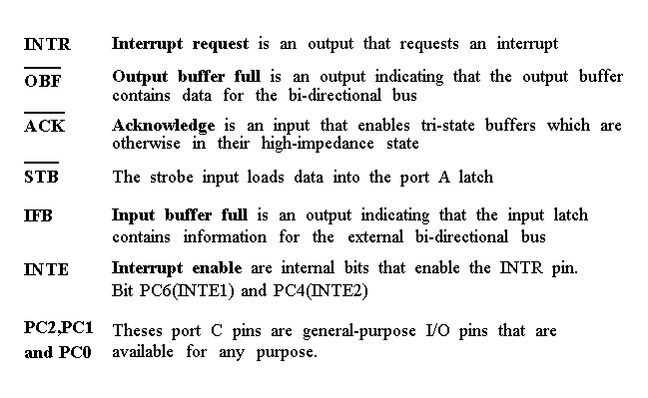
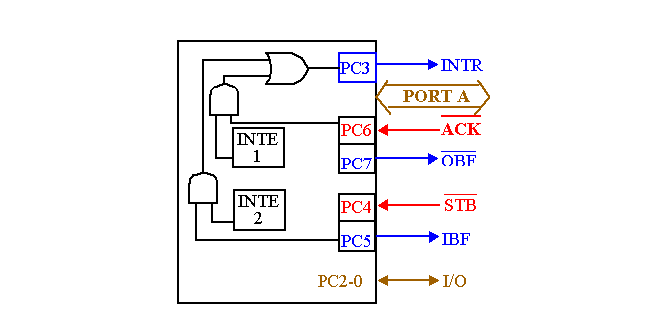
Timing diagram is a combination of the Mode 1 Strobed Input and Mode 1 Strobed Output Timing diagrams.

Slide 40
Thank you
Q&A

Slide 41

Go Back

Slide 42

Go Back

Slide 43
Go Back

Slide 44
Go Back

